Slide 1
PRESENTATION ON CUSTOMER RETENTION
PREPARED BY :
Mohini Chauhan

Slide 2
Problem Statement:
To understand the factors that contributed to the success of an online store.
To understand what made a customer purchase repeatedly from a particular store.
The objective was also to know how online websites retain their customers.

Slide 3
EDA steps and Visualizations:
The analysis has been done using Python methods and libraries and following findings have been achieved through visualizing them.
The data is collected from the Indian online shoppers. Results indicate the e-retail success factors, which are very much critical for customer satisfaction. All the most commonly websites like Amazon.in, Flipkart.com, Myntra, Snapdeal , Paytm etc. have been considered.
The analysis includes a step-by step evaluation of the responses of the customers.

Slide 4
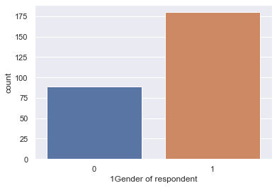
Step 1 : Distribution of Male and Female customers who buy online :
This was analyzed using a countplot. Females are more into online shopping than males.

Slide 5
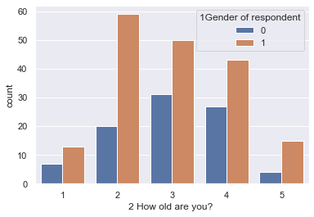
Step 2: Distribution of male and female buyers agewise:
This was analyzed again using a countplot. In this the result was obtained agewise.

Slide 6
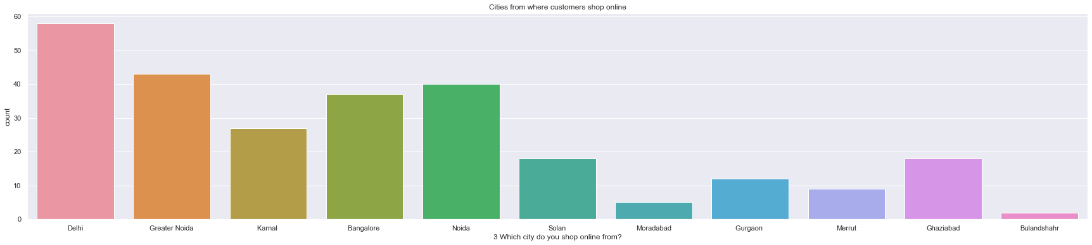
Step 3: Citywise inclination of online shopping :
Delhi followed by Greater Noida, Banglore, Noida , Karnal and Ghaziabad are the cities of most of the online shoppers.

Slide 7
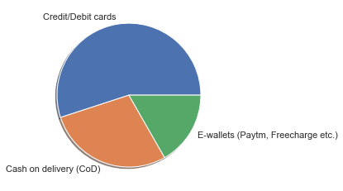
Step 4: To analyse the most preferred payment option :
This is indicated using a pie chart. Debit/credit cards are mostly used.

Slide 8
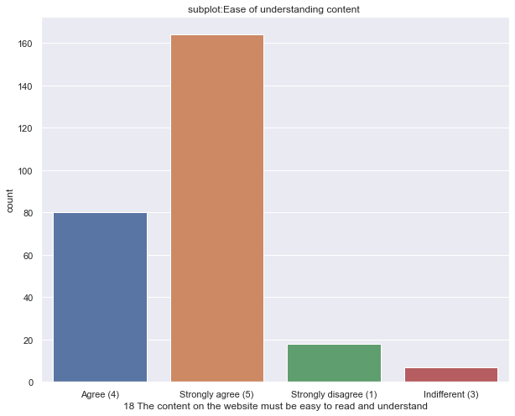
Step 5: How useful the content information is in determining a successful website for shopping online.
This is indicated using subplots: Content information plays a mojor role here :

Slide 9
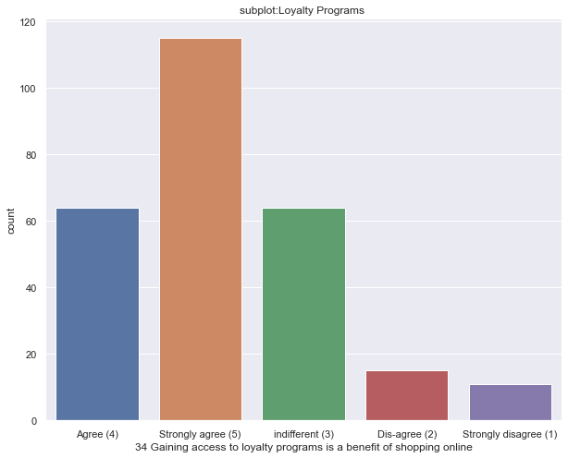
Step 6. Analyzing the customers opinion on what benefits they get from shopping online and how much that benefit is important to them. Customers strongly agree that they get benefits by shopping online.

Slide 10
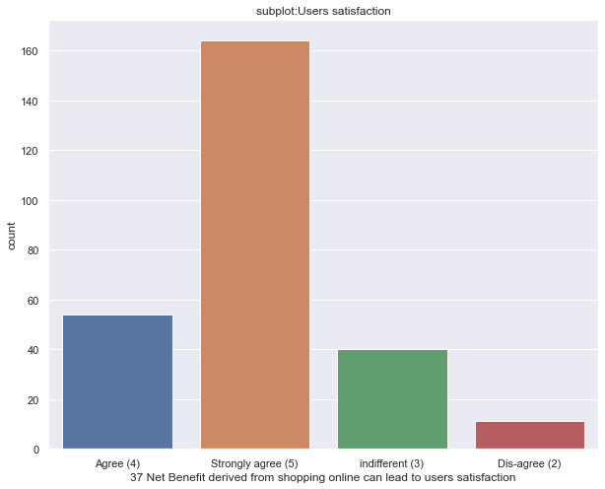
Step 6 : Analyzing the customer satisfaction through shopping online and what impacts it.

Slide 11
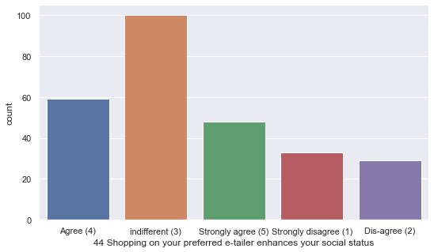
Step 7: Analyzing whether Online Shopping helps in achieving Gratification: Customers are indifferent to this .

Slide 12
Findings :
1. The trend for online shopping has started since more than 4 years back. The customers are driven to their favourite online shopping site through search engines. More females of 21-30 years are into online shopping than males.
2. Most preferred payment option is debit/credit cards and availability of more payment options attract the customers.
3. Delhi followed by Greater Noida, Banglore, Noida , Karnal and Ghaziabad are the cities of most of the online shoppers. Customers mostly shop online using their smartphones and mobile internet. Customers take more than 15 minutes for making any purchase decision.

Slide 13
Factors Impacting Online Stores :
1) Information quality
2) System Quality
3) Service quality
4) Trust
5) Net Benefit

Slide 14
Recommendations and Conclusions :
Delighting your customers through better customer experience leads to higher user engagement and overall higher customer satisfaction and growth.
Deliver what you promise. Most customers are understanding and empathetic as long as you are upfront about your limitations.
Building strong customer relationships is also critical
For ecommerce stores, going the extra mile by including a handwritten note or including free shipping with the order can elevate the user experience and create a fleet of loyal customers.
Setting up regular nurture streams that communicate consistently to your customer keeps leads engaged until they are ready to make their next purchase.

